Slide 1


Health Monitoring
By
V.Anusha
V.Srivalya
N.Supraja
K.Tejasree

Slide 2

Monitoring in ICU

Slide 3

Attributes
Diastolic bloodpressure
Systolic blood pressure
Pulse
Temperature

Slide 4
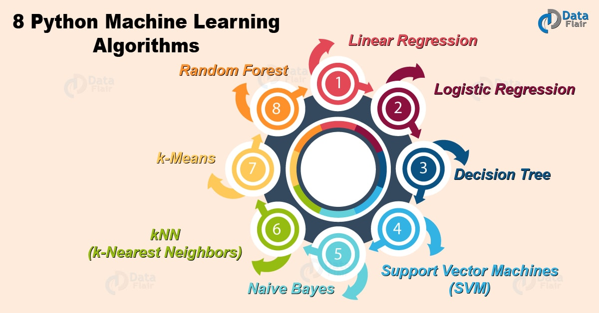
Algorithms in M.L

Slide 5
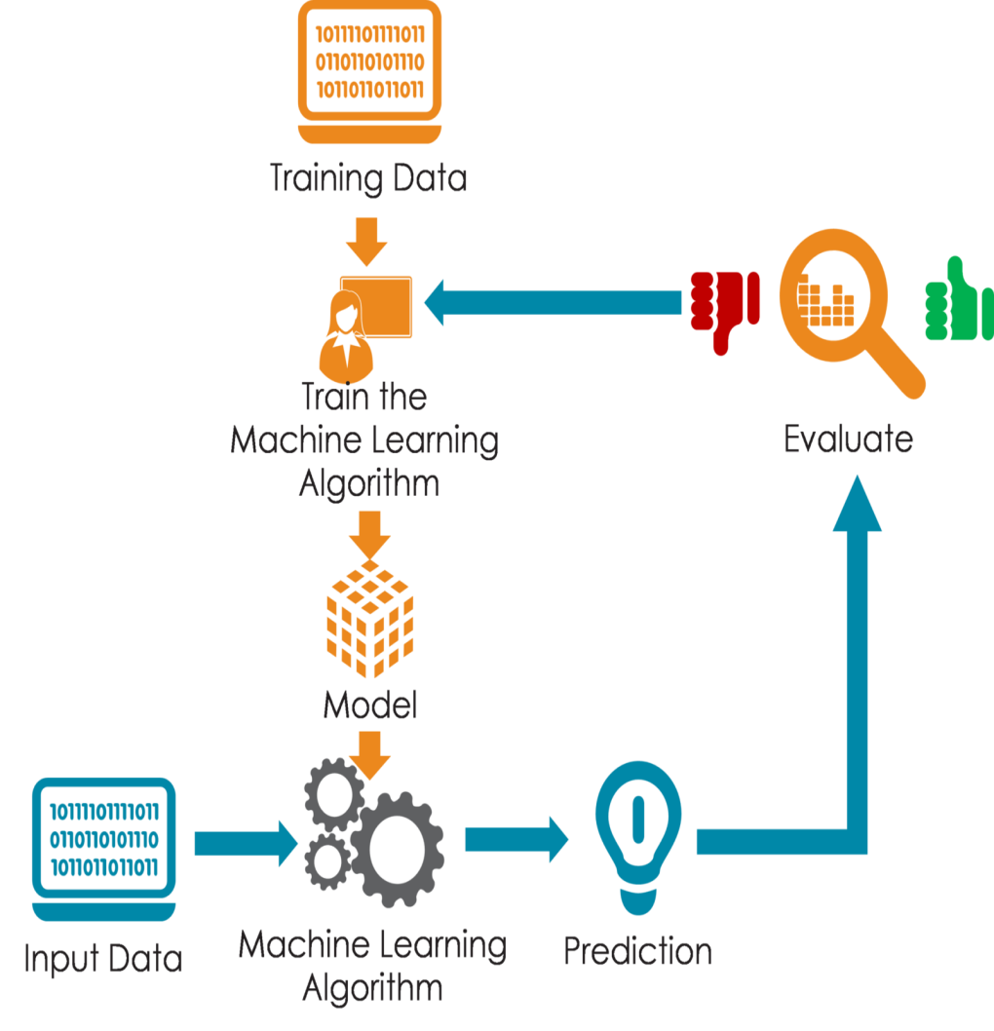

Block diagram
DBP
SBP
Temperature
Database
PULSE

Slide 6



Deployment Process
Logistic regression
Web Application
Web Application
IBM Watson Studio

Slide 7
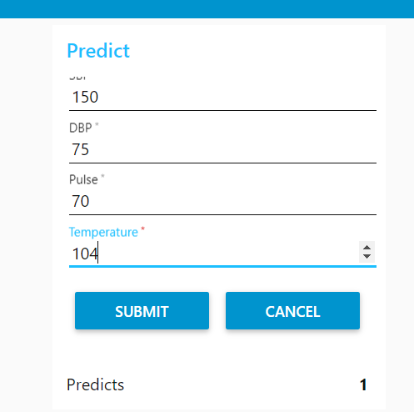
Conclusion

Slide 8


